Slide 1
Introduction to Generative AI
1

Slide 2
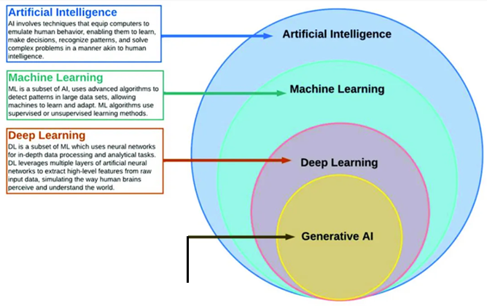
What is Generative AI
A generative model describes how a dataset is generated, in terms of a probabilistic model.

Slide 3
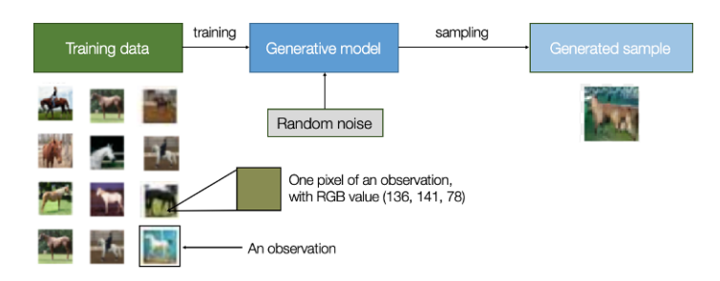
Generative model
A function that takes random noise and produces new data.
Sampling = Creating a new example from the model
Random noise is essential in generative models because it gives the model the ability to generate many different outputs, not the same image every time.
Every observation is represented by a set of features—for image-generation tasks, these features correspond to pixel values.

Slide 4
Why is it called a probabilistic model?
Because the model learns and uses probabilities — not fixed rules — to generate new data.
In simple words:
The model learns which kinds of images are more likely and which are less likely.
It uses randomness (probabilities) to decide what type of image to generate.
So the output is never fixed — it depends on chance and the learned probability distribution.

Slide 5
A generative model learns the patterns of the training data (e.g., horse images).
We give the model random noise (just meaningless random numbers).
The model uses this randomness to create new samples that look like real data.
This randomness makes the model stochastic, so every output is different.
Generating a new image from noise is called sampling.

Slide 6
Discrimitive model

Slide 7
Difference Between Generative Model and Discrimitive model
Discriminative Models
Goal ------------------- Prediction or Classification
It is Supervised learning -------------------------- It requires labelled data
Sufficient training data is required for better prediction accuracy.
A discriminative model learns a function that maps input features to output labels using a labeled dataset.

Slide 8
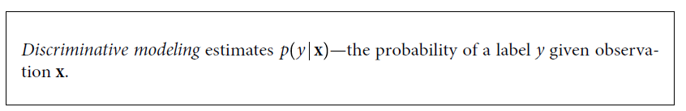
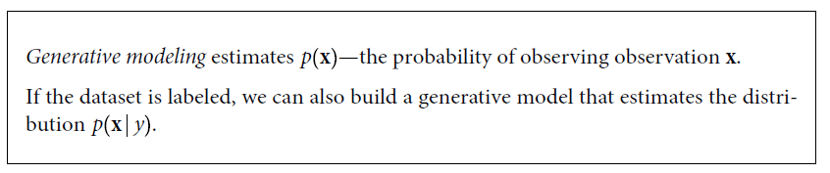
Unlabeled data ------- Unsupervised Learning
Supervised Learning

Slide 9
The Generative Modeling Framework
A set of points in two dimensions, generated by an unknown rule p_{data}

Slide 10
The orange box, p_{model}, is an estimate of the true data-generating distribution, p_{data}

Slide 11
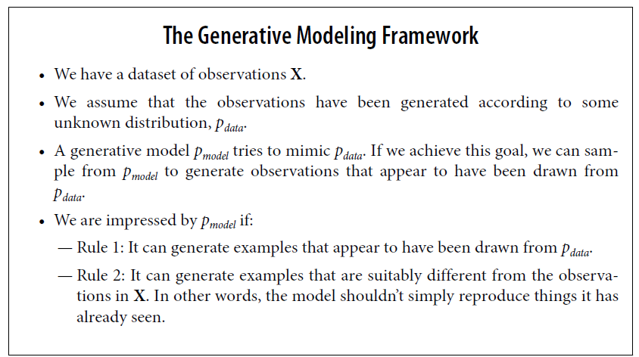

Slide 12
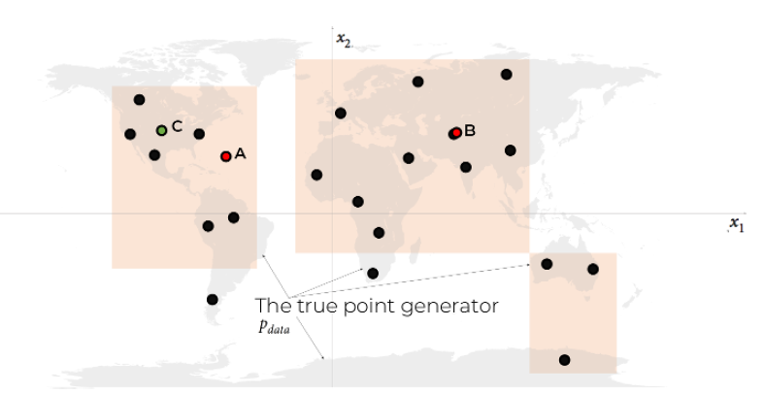
As we can see from Figure, the data-generating rule is simply a uniform distribution over the land mass of the world, with no chance of finding a point in the sea.
p_{data}
The orange box, p_{model}, is an estimate of the true data-generating distribution p_{data}
(the gray area)

Slide 13
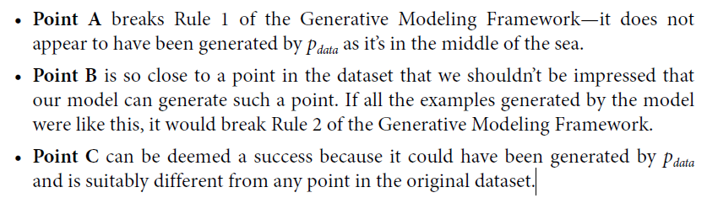

Slide 14
grounded purely in probabilistic
theory
Generative Model
As a first step, we shall define four key terms:
sample space,
density function
Parametric modeling
maximum likelihood estimation.

Slide 15
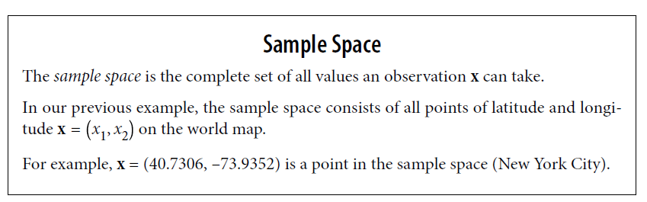

Slide 16
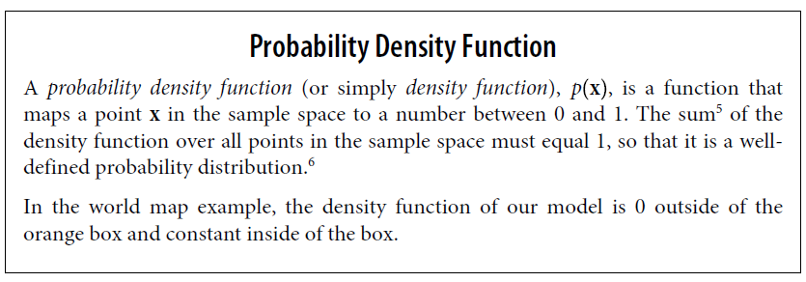

Slide 17
While there is only one true density function p_{data} that is assumed to have generated the observable dataset.
There are infinitely many density functions p_{model} that we can use to estimate pdata.
In order to structure our approach to finding a suitable p_{model}(X) we can use a technique known as parametric modeling.

Slide 18
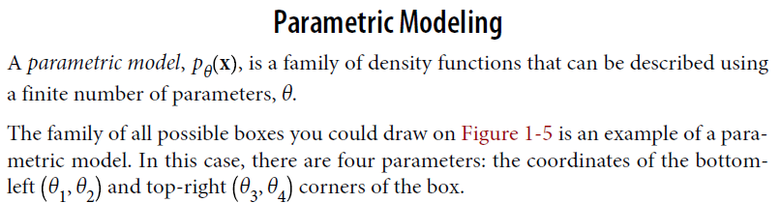

Slide 19
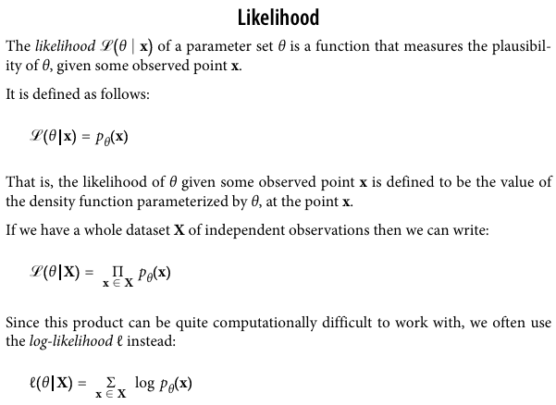

Slide 20
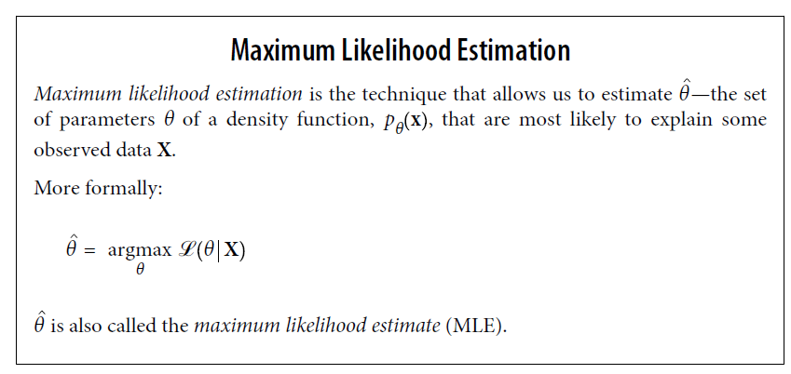

Slide 21
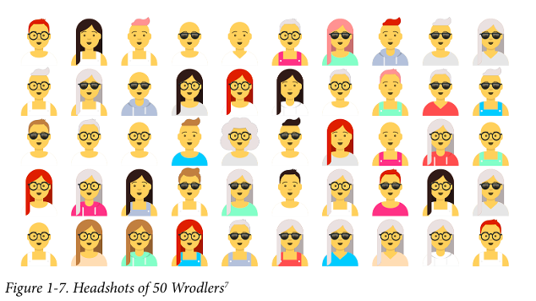

Slide 22
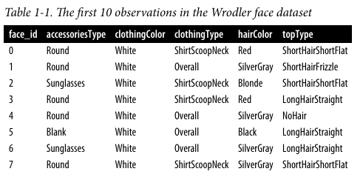

Each observation can be described by five features,
accessoriesType
clothingColor
clothingType
hairColor
topType

Slide 23
The possible values for each feature include:
7 different hairstyles (topType): —NoHair, LongHairBun, LongHairCurly, LongHairStraight, ShortHairShort Waved, ShortHairShortFlat, ShortHairFrizzle 6 different hair colors (hairColor): —Black, Blonde, Brown, PastelPink, Red, SilverGray
3 different kinds of glasses (accessoriesType): —Blank, Round, Sunglasses
4 different kinds of clothing (clothingType): —Hoodie, Overall, ShirtScoopNeck, ShirtVNeck
8 different clothing colors (clothingColor): —Black, Blue01, Gray01, PastelGreen, PastelOrange, Pink, Red, White.

Slide 24
There are 7 × 6 × 3 × 4 × 8 = 4,032 different combinations of these features, so there are 4,032 points in the sample space.
The problem is that we do not know p_{data} explicitly—all we have to work with is the sample of observations X generated by p_{data} .
The goal of generative modeling is to use these observations to build a p_{model} that can accurately mimic the observations produced by p_{data} .

Slide 25
To achieve this, we could simply assign a probability to each possible combination of features, based on the data we have seen.
Therefore, this parametric model would have d = 4,031 parameters—one for each point in the sample space of possibilities, minus one since the value of the last parameter would be forced so that the total sums to 1.
Thus the parameters of the model that we are trying to estimate are θ₁, . . .,θ₄₀₃₁ .

Slide 26

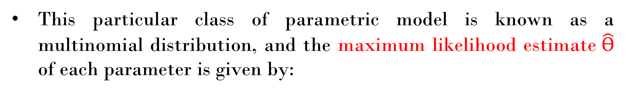
This particular class of parametric model is known as a multinomial distribution, and the maximum likelihood estimate$\hat{Ѳ}$ of each parameter is given by:

Slide 27
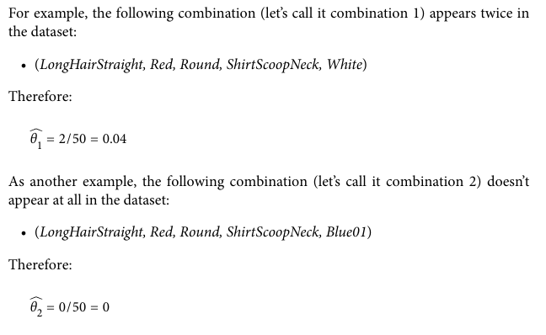

Slide 28

To address this, we could assign an additional pseudo count of 1 to each possible combination of features. This is known as additive smoothing. Under this model, our MLE for the parameters would be:

Slide 29
This model allows every possible image to be generated, even images that were never in the original data.
But the problem is that it treats all new images the same way.
It cannot tell which images look real and which are just random noise.
For example, if we use this model to generate Picasso paintings, it will give the same importance to:
a random picture made of colorful pixels, and
a painting that looks almost exactly like a real Picasso painting.
Because of this, the model is not good at generating realistic data.

Slide 30
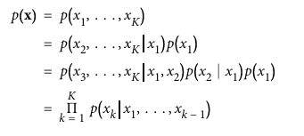
Naive Bayes
The Naive Bayes parametric model makes use of a simple assumption that drastically reduces the number of parameters we need to estimate. We make the naive assumption that each feature x_{j} is independent of every other feature x_{k} .
To apply this assumption, we first make use of the chain rule of probability to write the density function as a product of conditional probabilities:

Slide 31
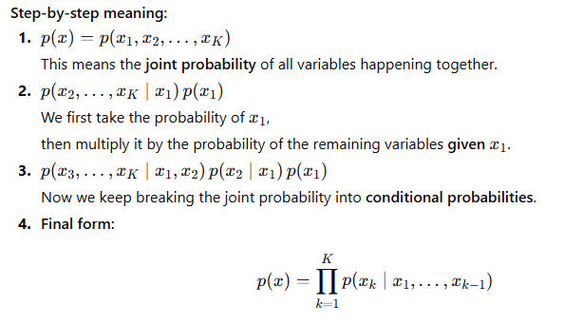

Slide 32
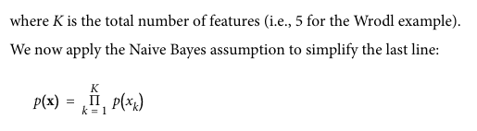

Slide 33
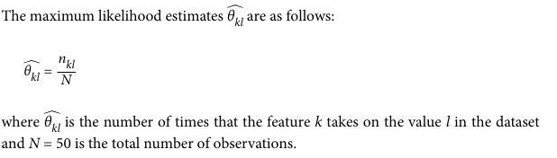

Slide 34
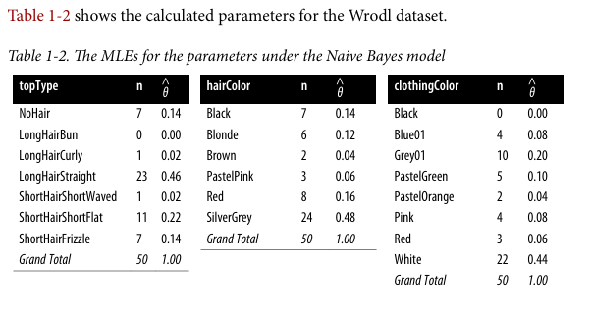

Slide 35
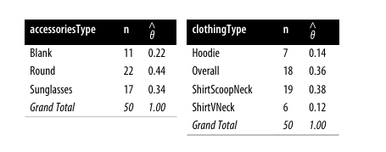

Slide 36
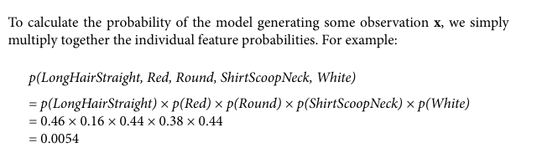

Slide 37
Loss Functions in Generative AI
Loss functions are a crucial component in the training process of generative models, as they quantify the difference between the model’s predictions and the ground truth.
In the context of generative AI, these functions help guide the optimization process, enabling the model to generate realistic and diverse samples.

Slide 38
Role of Loss Functions in Generative AI
In generative AI, the primary goal is to learn a model that can generate new data samples that resemble the training data.
Quantifying the discrepancy: Loss functions measure the difference between the model’s predictions and the actual data, providing a numerical value that represents the model’s performance.
Guiding optimization: By minimizing the loss function, the model’s parameters are updated to generate more accurate and realistic samples.
Balancing objectives: In some generative models, multiple loss functions are combined to balance different objectives, such as generating realistic samples while maintaining diversity.

Slide 39
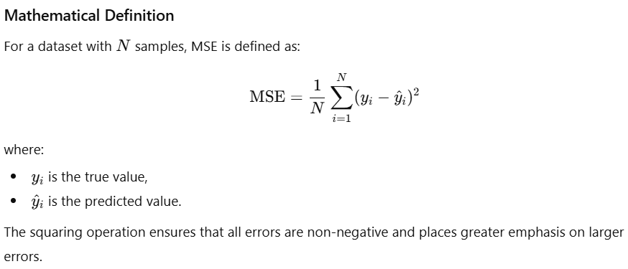
Types of Loss Functions in Generative AI
Mean Squared Error (MSE):
Mean Squared Error (MSE) is one of the most commonly used loss functions in machine learning and generative modeling. It measures the average of the squared differences between the predicted values produced by a model and the corresponding ground-truth values.

Slide 40
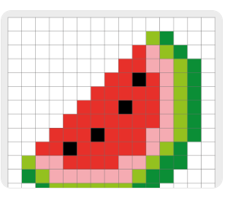
Role of MSE in Generative AI
In generative AI, particularly in image generation and reconstruction tasks, MSE is commonly used as a pixel-wise reconstruction loss.
The loss compares each pixel of the generated image with the corresponding pixel in the ground-truth image and penalizes differences between them.

Slide 41
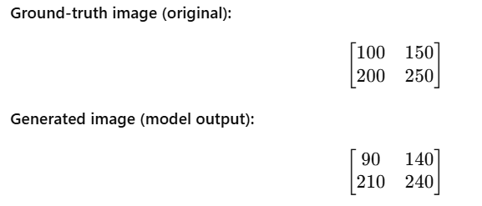
Assume a very small image
For easy understanding, consider a 2 × 2 grayscale image (pixel values range from 0 to 255).

Slide 42
Calculate pixel-wise error
Subtract each generated pixel from the corresponding true pixel and square it:
Pixel position | True | Generated | Difference | Squared Error
(1,1) | 100 | 90 | 10 | (10² = 100)
(1,2) | 150 | 140 | 10 | (10² = 100)
(2,1) | 200 | 210 | −10 | (-10)² = 100 )
(2,2) | 250 | 240 | 10 | (10² = 100)

Slide 43

Each pixel is compared independently
Bigger pixel differences → larger penalty
The model is encouraged to make generated pixels numerically close to the original image

Slide 44
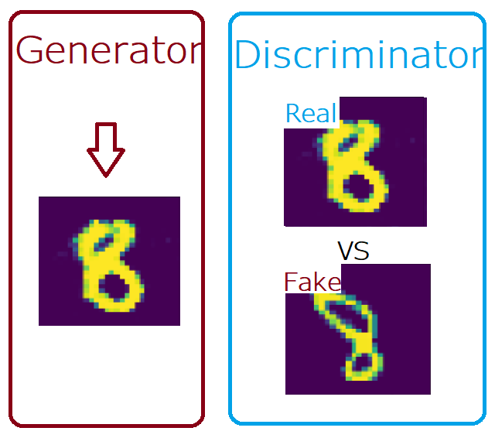
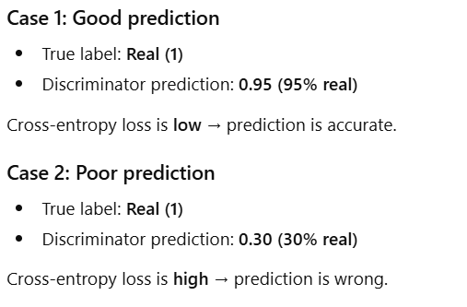
Binary Cross-Entropy Loss
Cross-entropy loss measures the dissimilarity between two probability distributions, making it suitable for classification tasks.
In generative AI, cross-entropy loss is often used in GANs, where the generator tries to generate samples that the discriminator cannot distinguish from real data.

Slide 45
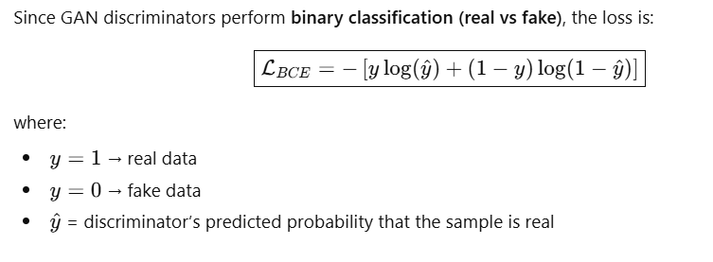

Slide 46
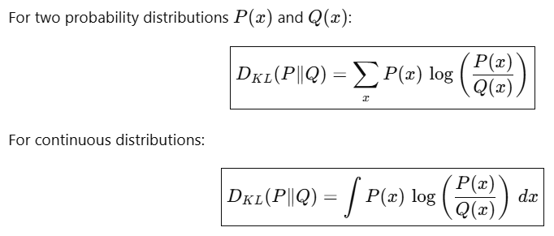
Kullback-Leibler (KL) Divergence
KL divergence is a measure of how one probability distribution differs from a reference distribution.
In generative AI, KL divergence is often used in VAEs as a regularization term to ensure that the learned latent distribution is close to a predefined prior distribution, such as a standard normal distribution.

Slide 47
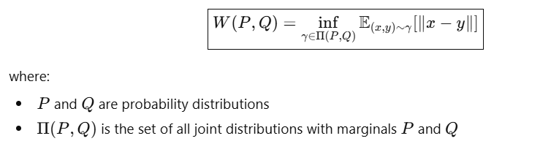
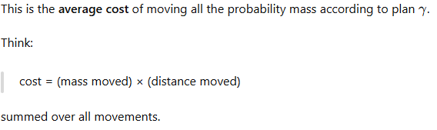
Wasserstein Distance
Wasserstein distance, also known as the Earth Mover’s distance, measures the minimum cost of transporting mass to transform one probability distribution into another.
It has gained popularity in generative AI due to its use in Wasserstein GANs (WGANs), which provide more stable training and better convergence properties compared to traditional GANs.

